Slide 1
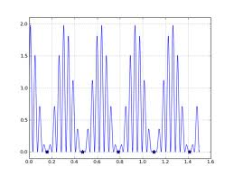
Non-Linear Equations
Group 1

Slide 2
Group 1 - agenda
Debajyoti Nag – Introduction
Roberts Zenteils – Bisection Method
Omer Saleh – Newton Method
Gerard Duff – Secant Method
Yasser Najib – False Position Method
Katerina Mardusevich – Brent’s Method

Slide 3
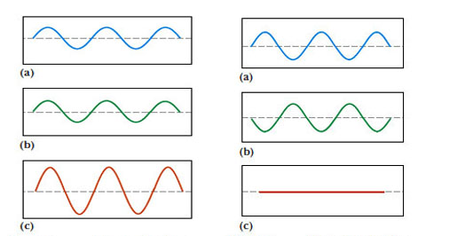
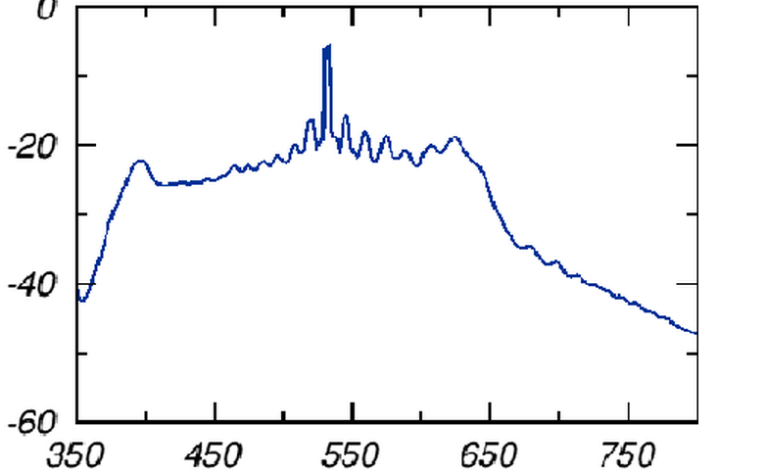
NOT linear
Does not satisfy “superposition principle”
Output NOT directly proportional to input
graph does not form a straight line

Slide 4

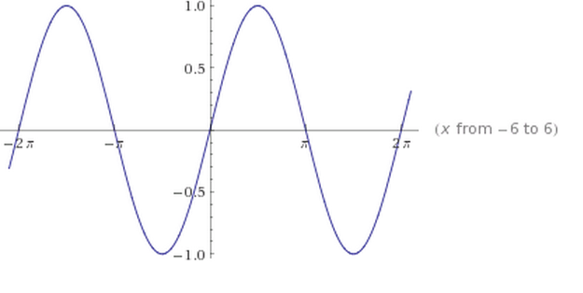
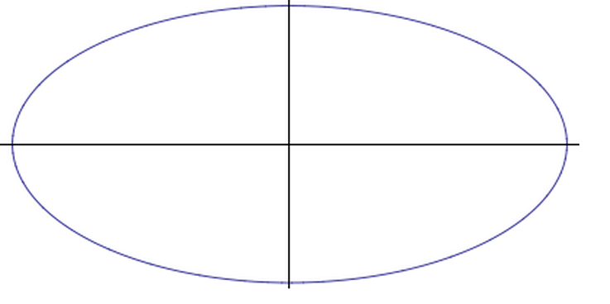

Examples
Quadratic Equations
Example
Trigonometric Functions
Example : Sin x
Parabola, Ellipse, Circle

Slide 5

Discriminant (D)
function of its coefficients which gives information about the nature of its roots
Formula (quadratic) :
Significance :
Number of roots
Nature of roots

Slide 6
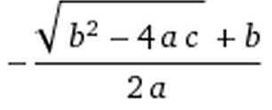
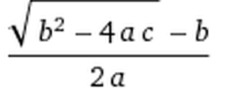
Roots
Real and Imaginary
Dependency on discriminant
Significance (touches x-axis or not)
D > 0 -> Real roots
D < 0 -> Imaginary roots
D = 0 -> Unique root
Formula (quadratic):

